Slide 1

Exploratory Data Analysis: The Movie Dataset
Jonathon Scroggins
DSC 530
3/4/2021
Professor Parajulee

Slide 2
Introduction
The topic for my term project: The Movie Industry
Data obtained from: https://www.kaggle.com/danielgrijalvas/movies
This dataset is comprised of statistics that come from IMDB (The International Movie Database)

Slide 3
Main Statistical Questions
The main statistical questions that I will explore in this data set are:
Does the NPAA rating of a movie effect the score the movie receives from user votes?
Is a rated R movie more likely to gross more than other ratings?
Through that exploration, I look to also explore the following:
Is there any correlation between the score of a movie and the gross of the movie?

Slide 4
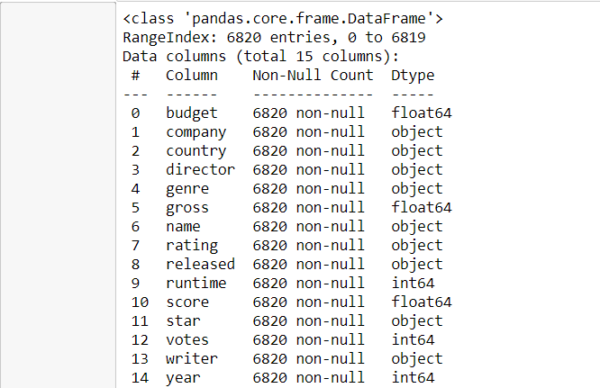
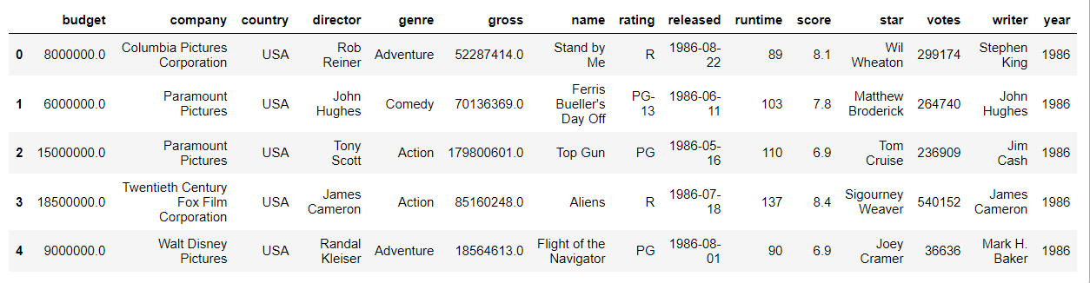
The Data
Here is a glimpse at the data:

Slide 5
The Data
All of the Variables of the data
The budget for the film – if not available it is put as a zero
The production company
The country of origin
The director of the film
The genre of the film
The gross earnings of the film
The title of the film
The film’s rating
The year it was released
The length of the film
The score the film received from the user votes of how they liked the film on a 10 point scale
The main star of the film
How many votes the film received
The writer of the film
The year the film was released
The variables I will focus on
Budget - budget
Gross earnings - gross
Length of the film – runtime
The score – score
Votes received – votes
The film’s rating – rating
I have chosen to focus on these because these are the most relevant to answer the questions I am exploring.

Slide 6
Now we will explore each the variables individually

Slide 7
I wanted to focus specifically on Domestic films, so the first thing I did was clean out all of the International films.

Slide 8
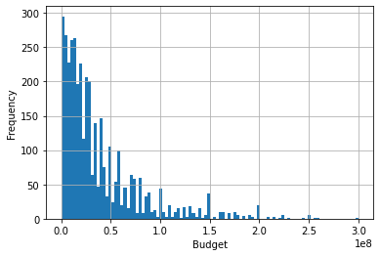
Budget
The first thing to do with the budget variable was to drop all the rows with a value of zero which indicated it was unknown and would be an outlier.
The histogram shows that the budget variable is skewed to the right.
The mean is 37559962.44
The variance is 1646871742493711.0
The standard deviation is 40581667.57

Slide 9
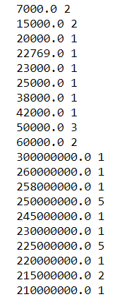
Budget
Due to the level of skewness of the graph I decided to look at the highest and lowest values to see if it looked like there were outliers and whether they should be removed.
In this case, though there is a big spread in the data, I do not feel these outliers should be removed at this time to build a better model.

Slide 10
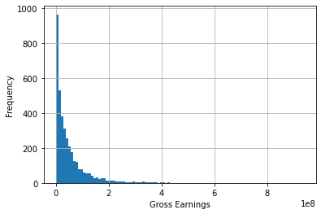
Gross
The histogram for gross also shows a positive skew
The mean is 50031178.03
The variance is 4574995235211193.0
The standard deviation is 67638711.07

Slide 11
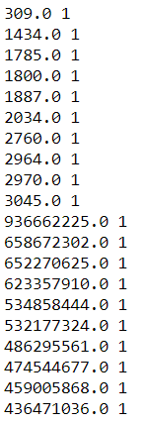
Gross
I also looked at the largest and smallest values, and again due to the nature of the analysis I did not clean out any of the values.

Slide 12
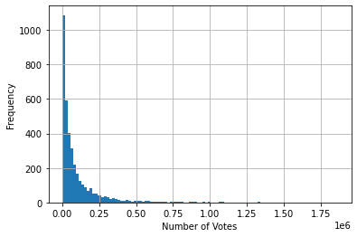
Votes
Looking at the histogram for the number of votes shows a positive skew.
Due to the nature of the analysis and questions I am answering, I decided not to explore this variable any further. I may however include it in the regression analysis, but I will wait and see.

Slide 13
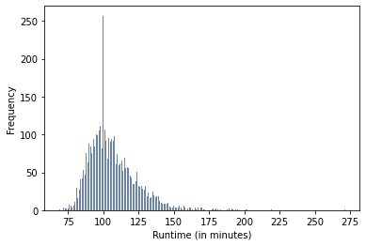
Runtime
The histogram for the runtime shows a bit of a positive skew due to a tail that goes towards the longer movies.
The mean is 106.8
The variance is 299.38
The standard deviation is 17.3

Slide 14

Runtime
I again decided to look at the smallest and largest values. Though I am more tempted to pull out some of the higher values as outliers, I again feel that would not do justice to the type of analysis I am doing on movies. So I will leave them in.

Slide 15
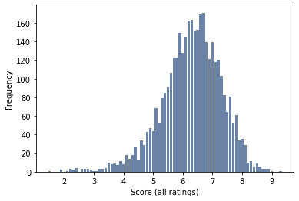
Score
This histogram for score is slightly skewed to the left, but I feel like it is a good normal distribution of the data.
The mean is 6.29
The variance is 1.0
The standard deviation is 1.0

Slide 16
Exploring the Score variable and the Ratings

Slide 17
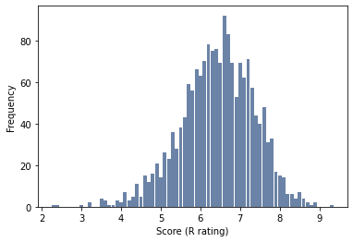
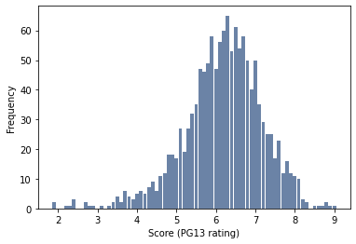
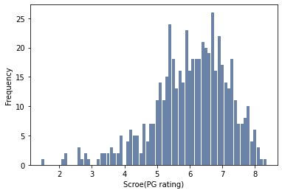
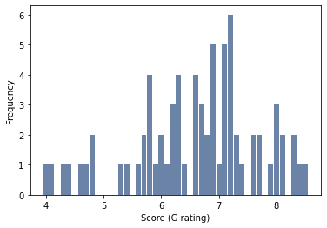
Individual Ratings Score Histograms
In order to see if the rating of a movie influenced the score of a movie, I made a histogram of the scores of each individual rating

Slide 18
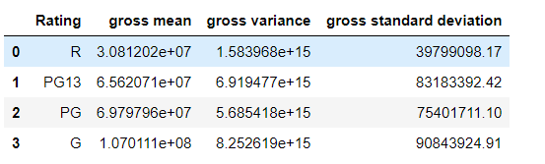
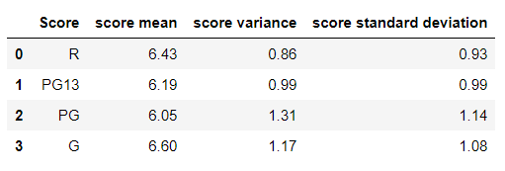
Individual Ratings Score Stats

Slide 19
Score and the Ratings
After looking at the histograms and stats for the score based on the rating of the movie, I would say that the R rating and PG13 rating have the most normally distributed data and score higher on average. Even though the G rating has the better overall mean, the data is not very well distributed.
The following slide will compare the PMFs of R(Green, dark blue) and PG13(Dark blue in first, light blue in second).

Slide 20
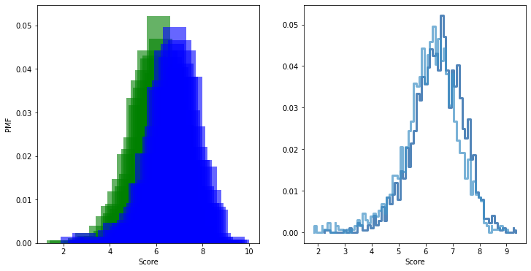
Comparing R and PG-13

Slide 21
Score and Rating
The PMFs on the previous slide shows the score of the R rated movies vs the score for the PG13 rated movies.
The PMFs show the probability of the scores in the data set.
This comparison shows that the PG13 movies have a higher probability of slightly higher scores.

Slide 22
CDF

Slide 23
CDF
Next, we will look at the CDF of the score variable and then compare the CDF of the score of rated r movies and PG13 movies like we did with the PMFs to get an idea of what the percentile ranks of the data looks like.

Slide 24
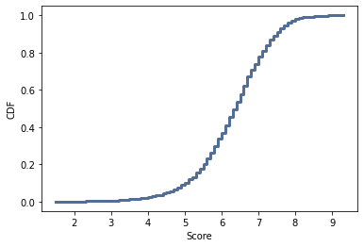
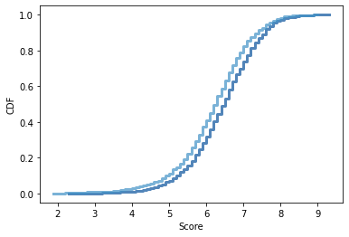
Score CDF
If we look at the first score CDF it looks like about 40 % of the movies score higher than 6.
If you look at the second CDF, again here we can see that the PG13 movies scores trend higher with more movies in the higher percentiles

Slide 25
Lognormal Distribution

Slide 26
Lognormal Distribution
For the gross variable, I decided to see if it would fit a lognormal distribution better than a linear distribution.
On the next slide there is a graph of the linear scale and log scale for the gross variable.

Slide 27
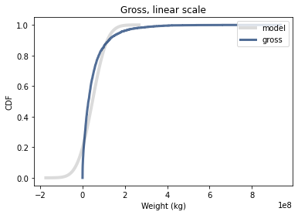
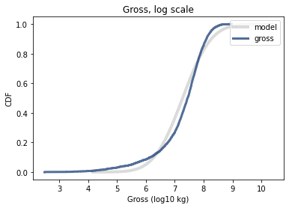
Gross Linear Scale vs Gross Log Scale

Slide 28
Lognormal Distribution
As you can see on the previous slide, the gross variable does not fit the linear scale very well. However, when the put in the log scale it does not deviate as much from the means of the original so I would say that the lognormal distribution is a good fit for this data.

Slide 29
Correlation

Slide 30
Correlation
For this section I want to look at the correlation for:
Budget and Gross
Score and Gross

Slide 31
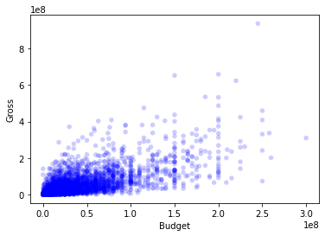
Budget and Gross
First, we can look at the scatterplot for the budget and the gross of the movies.
Looking at the scatterplot, it looks like there might be a slight correlation so we should look at the Pearson’s coefficient.
The Pearson’s coefficient is 0.67 which shows a strong correlation.

Slide 32
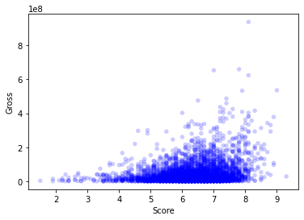
Score and Gross
Looking at the scatter plot fir score and gross, I am not as impressed with the correlation between the two of them, so let's look at the Pearson’s coefficient.
The Pearson’s coefficient for these variables is 0.27 which shows a not as strong correlation.

Slide 33
Hypothesis Test

Slide 34
Hypothesis Tests
For this project, I ran both a Difference Means test and a correlation test on the budget and gross variables to see what effect the budget would have on the gross, especially since before the correlation was shown to be significant.

Slide 35
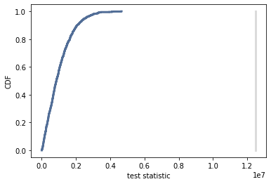
Difference Means and Correlation Test
The difference in means test shows no intersection of the of the CDF and the observed difference, showing a p-value of 0 which shows significance.
I also performed a correlation test with a result of 0 again showing significance and a rejection of the null hypothesis.

Slide 36
Regression analysis

Slide 37
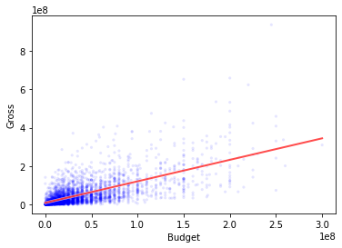
Regression Analysis
For my analysis, I first started by finding a least squares fit line for the scatter plot of budget and gross.

Slide 38
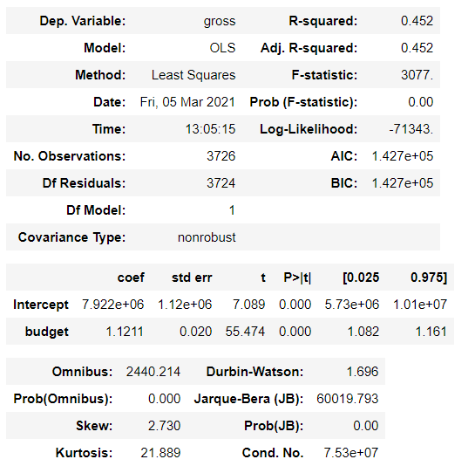
Regression analysis
I then looked at a linear regression model of the budget and gross variable using the budget as the predictor variable and the gross as the outcome variable.

Slide 39
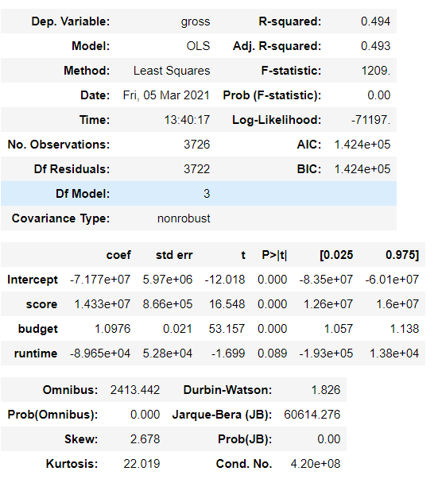
Regression analysis
I also did a multiple regression analysis with gross as the outcome variable and budget, score and runtime as the predictor variables.

Slide 40
Conclusion
I feel like the only conclusion I can make at this time is to say that there is a significant positive relationship between the budget of a movie and the gross earnings of a movie.
Some of the analysis points to a PG13 movie being more likely to score higher than the other movies, but I am unable currently to say there is a significant relationship between the score and the rating.

